Slide 1
Piramal Foundation & DBC
August 01 2023

Slide 2
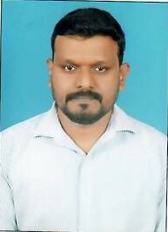



Self Introduction
Total 14 years in IT
Email: vijay.nuthalpati@piramalswasthya.org
2008
Worked as Sr, Tech Executive Project Dept. Sysnet Global New Delhi.
Phone: 9154622513, 8867987969
Worked as South Zone Tech Assistant Manager, in Project Dept. Geloofs Solution Pvt Ltd, In WIPRO Projects.
2010
2015
Worked as Team lead IT N & S Zolt Info solution Pvt Ltd, Worked for 104 HIHL CC Karnataka PSMRI project.
VijayaKumar Nuthalpati
System Administrator
Data Center HO
Hyderabad
2022
Working as System Administrator IT N & S, PSMRI Piramal Swasthya Research and Management Institute, Hyderabad HO, Begumpet Office.
Linux Certified,
AWS Cloud SysOps,
JetKing Certified Engineer,.
Security Engineer.

Slide 3
Piramal Foundation
Leaderships
Mr. Jalaj Dani
Mr. Debasish Mitter
Mr. Ajay Piramal
Chairman, Piramal Group
Mr. Madhav Chavan
Mr. Adil Zainulbhai
Dhaivat Anjaria
Ishmeet Singh
Pallav Patankar
Rajasekhar Kaliki
Piramal Foundation is the private initiatives, for the public good, focusing on quality of life under the arm of Piramal Group. Piramal Foundation Established in 2006 under the supervision of Mr. Ajay Piramal.
The foundation undertakes projects under the four broad areas – healthcare, education, livelihood creation and youth empowerment. These projects are rolled out in partnership with various communities, corporate citizens, NGO’s and government bodies.
BOARD OF DIRECTORS
OUR PRESENCE
The foundation’s operations is supported by 5000 employees spread across
STATES
27
UNION TERRITORIES
02
Details of All Big Bets and their respective leaders are available on the Foundation web site:
https://piramalfoundation.org/about-us

Slide 4
5 Big Bets
Transformation at scale needs a unique approach to address deep-rooted barriers, necessitating a large commitment of resources by bringing multiple partners together to strengthen systems and reach out to everyone.
The 5 Big Bets are designed to address the most underserved populations and ensure that no one is left behind.

Slide 5
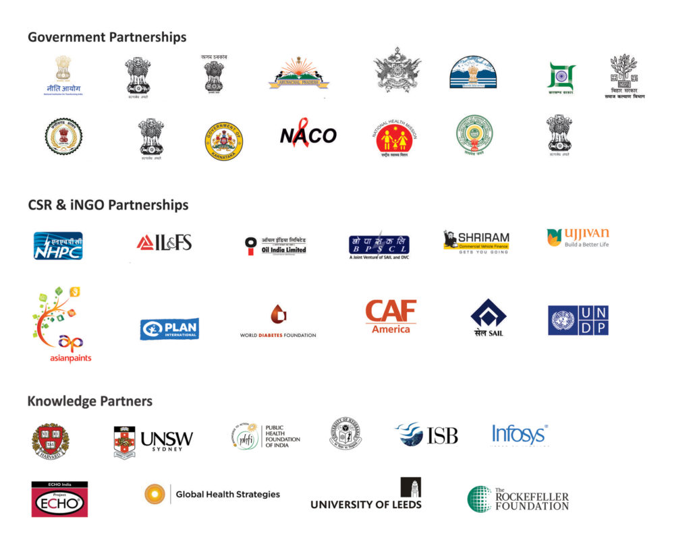


Our Partnerships

Slide 6

Digital Bharat Collaborative is a holistic digital transformation that re-engineers processes, improves observability, enables governance, and empowers people at all levels.
About Digital Bharat Collaborative (DBC)
Building state capacity
Empowering communities
Leveraging Digital Technology
Providing Continuum of Care
VISION
An India where every citizen enjoys equitable access to quality public service and equal opportunity to live to their fullest potential by Building state capacity, Empowering communities, Leveraging Digital Technology.
MISSION
Strengthen public systems with digital transformation to promote access to quality services and equal opportunities for all Indians.
Objective
Make AMRIT a Digital Public Good (DPG) in primary healthcare.
Increase transparency, collaboration, and innovation.
Cost savings and increased revenue
Offer an
open-source version of the software and
proprietary version of the software with additional features for our internal operations (MMU’s)

Slide 7


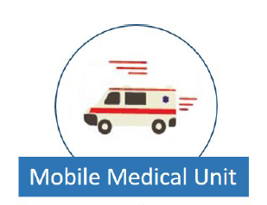

About Technology Partner WIPRO and AMRIT Platform
AMRIT : Accessible Medical Records via Integrated Technology
WIPRO ASSOCIATION
The basic tenants of the AMRIT platform focused on
Wipro as a part of the development program designed the AMRIT stack(aka iEMR)
AMRIT Platform Service Lines
104 HIHL: Provides services such as Medical Advice, Counselling, Grievance, Directory Service. NACO 1097: 1097 is National AIDS helpline. MCTS: Mother & Child Tracking System provides advice & counselling to Pregnant Women & Mothers with newborn child
Telemedicine: Provide medical advice to beneficiaries via video conferencing between Doctors, Specialists and Patient in remote location Clinic.
MMU: Mobile Medical Units are specially equipped vans that provide medical advice & diagnostics in rural areas
HWC: Supports health and Wellness Center with the services and is part of Ayushman Bharat Health and Wellness Center
Health Helpline
Telemedicine
HWC App

Slide 8
DBC Prescence in PAN INDIA
S.No. | State or Union Territory | 104 | 1097 | MCTS | TM/Facility App | MMU | ECD | ASHA App | Fetosense & Healthcube
1 | Uttar Pradesh
2 | Maharashtra
3 | Bihar
4 | West Bengal
5 | Tamil Nadu
6 | Rajasthan
7 | Karnataka
8 | Gujarat
9 | Andhra Pradesh
10 | Odisha
11 | Telangana
12 | Jharkhand
13 | Assam
14 | Chhattisgarh
15 | Himachal Pradesh

Slide 9
Health Information Helpline provides the medically validated advice, Health Related Schemes launched by various governments, health counseling services.
104 Health Help Line Objectives
104 Health Helpline
The main objective of 104 Medical Helpline number is to provide information and advice for health related services to general public seeking answers or resolutions for the following concerned areas:
Information Directory for tracking health services providers/institutions, diagnostic services, hospitals etc.
Complaint Registration about person/institution relating to deficiency of services, negligence, corruption, etc. in government healthcare institutions.
Advice on long term ill conditions like diabetes, heart issues etc.
Response to health scares and other localized epidemics.
Counseling and advice (stress, depression, anxiety, post-trauma recovery, HIV, AIDS, RTI, STI etc.)
Health and symptoms checker (initial assessment, flu advice, pregnancy related information etc.)
First aid information and advice.
Any other health related services/issues.
Played Major role COVID Awareness also supported as COVID help line in lockdown period.

Slide 10




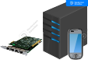






104 HIHL Technical Call flow Details
HA Data Center
CRM Application Server
Beneficiary calling 104
BSNL ISDN IN Network
CTI Server
Toll free num
18004256691
PRI DID num
040 23556691/040 23556692
PRI Card
Mobile Network
PRI CPE device
Database Server
Call Flow:
Beneficiary calls 104 from mobile.
Call is then routed to Mobile Network were 104 Short code number is converted to Toll free num via mapping.
Now when call is redirected to toll free num, BSNL ISDN Intelligent network routs call to PRI line which it is registered.
PRI provisioned for 104 are terminated in our HA Datacenter to BSNl CPE device and its is connected to CTI Server PRI card.
Now CTI server with the help of PRI card converts voice call to system understandable format and then routs the call to Agent System SIP Softphone with synchronization of Application CRM server and Database server, so that they all work together and give seamless experience to Agents and Beneficiary on call.
The call routing is handled by CTI server, were call landing to agent is decided by Call Que manager configured in CTI server.
CTI Server Backup
Call center Agents
HAO Agent
CO
SIO
MO

Slide 11
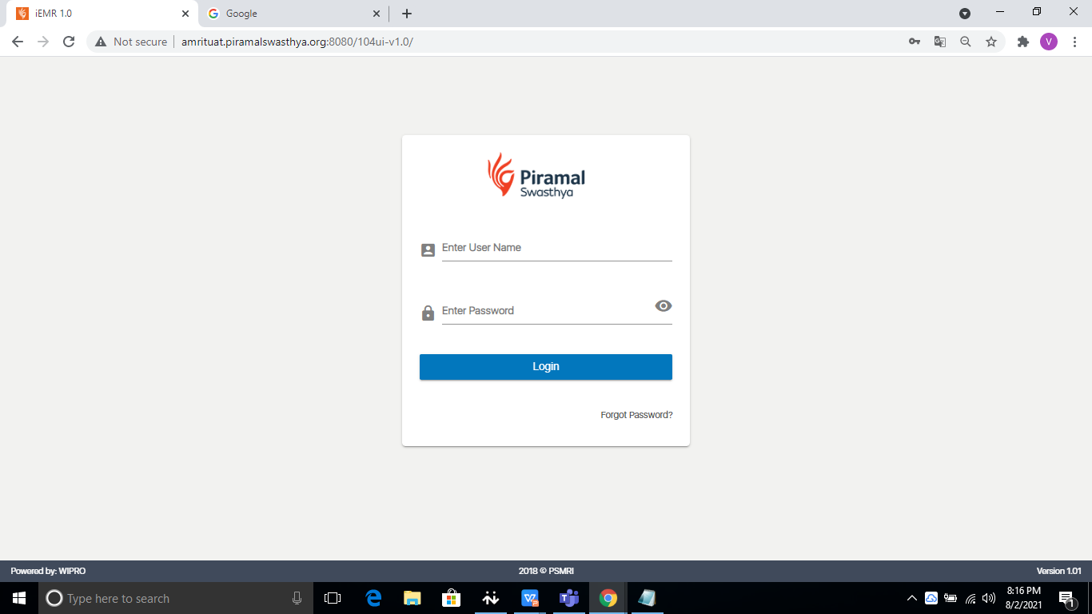
RO/HAO Login
104 Application CMR Page for User to Login
Enter the username and password and tap on Login to proceed further

Slide 12
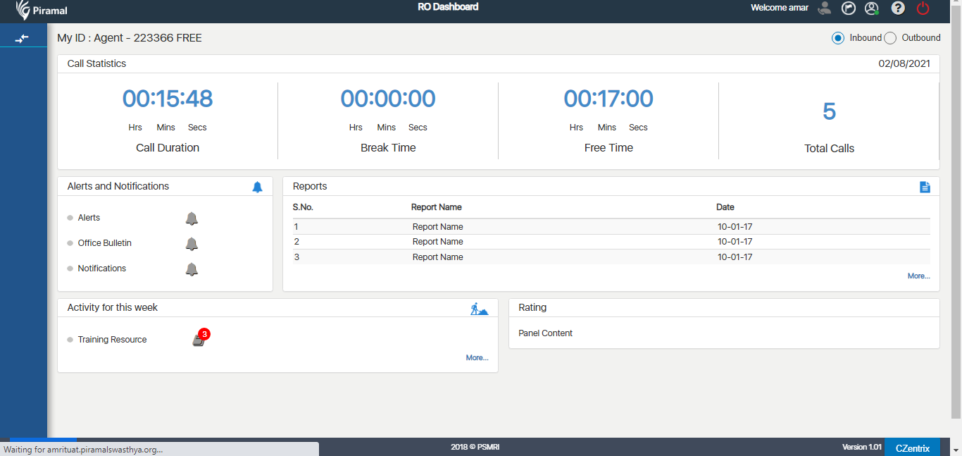
RO Dashboard
104 Application CMR Page post login of Agent

Slide 13
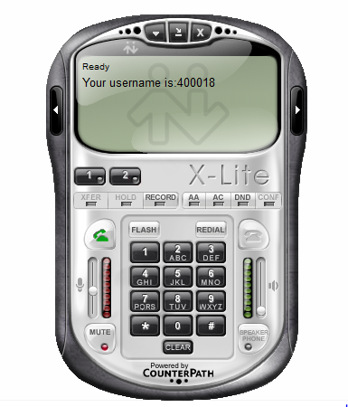
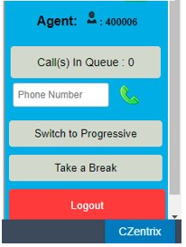
X-Lite/Czentrix Process Detail​
SIP setting for X-lite should be configured before login​
CO should login into the X-lite soft phone​
Cross check that Agent/CO is logged​ into the C-zentrix as well​
Note: SIP settings to be provided by System Admin, if not provided
already​

Slide 14
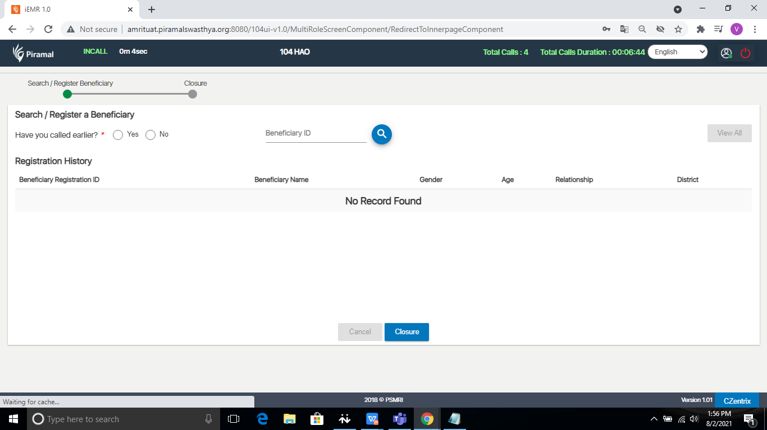
Beneficiary Registration
Application check if the caller is already registered in the system.
Incase beneficiary calls from the same phone/ mobile number as before, application identifies the number and displays the registration history
If not, fresh registration of the beneficiary is done by the RO/ HAO

Slide 15
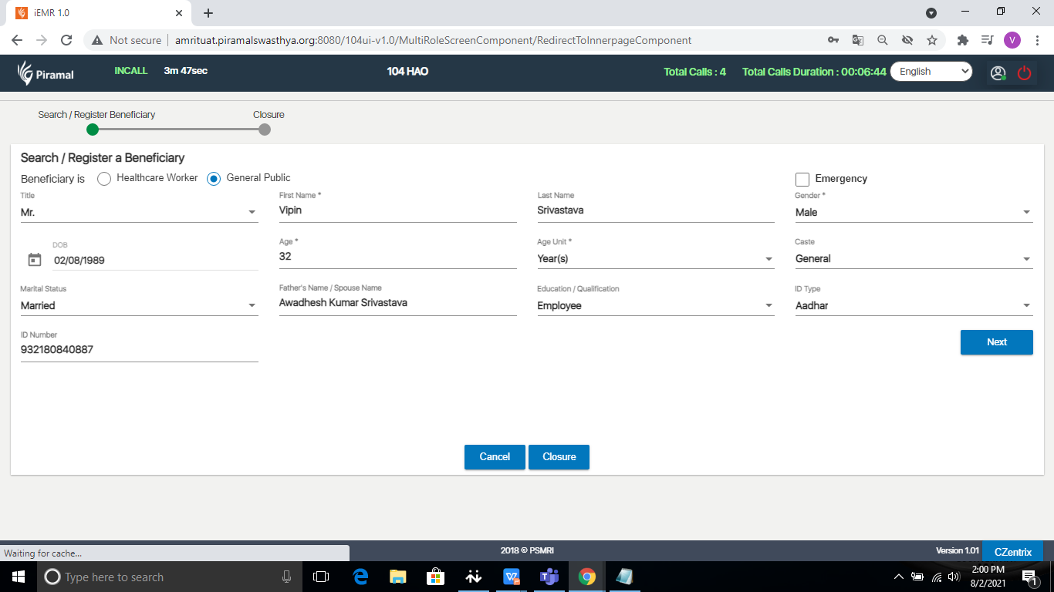
Beneficiary Registration
15
Enter the basic details of Beneficiary

Slide 16
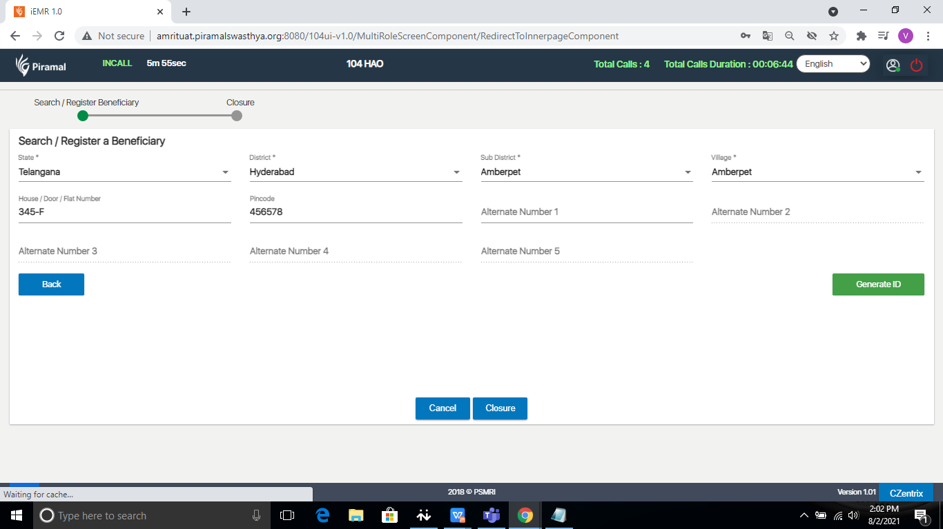
Beneficiary Registration
16
Enter the address of Beneficiary and tap on Generate ID

Slide 17
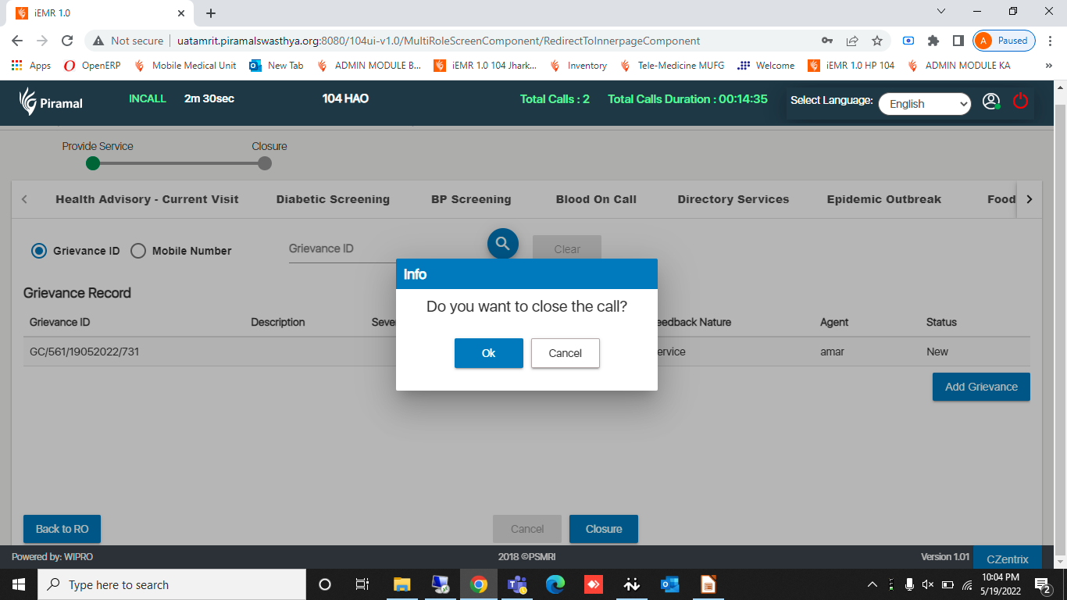

Slide 18
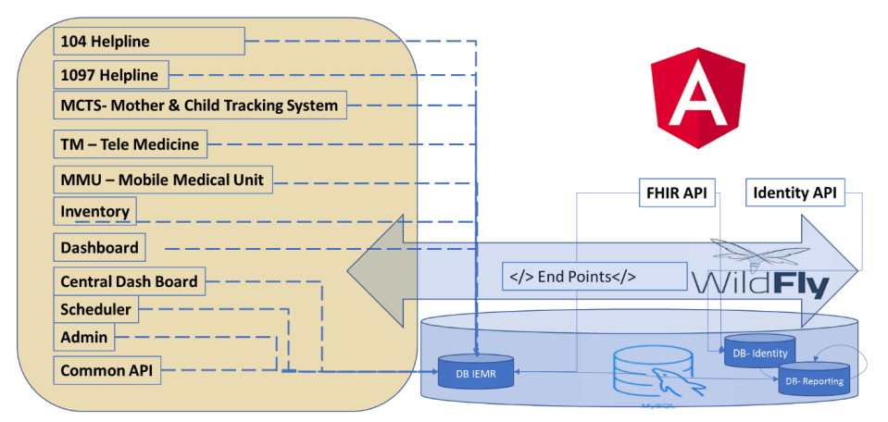
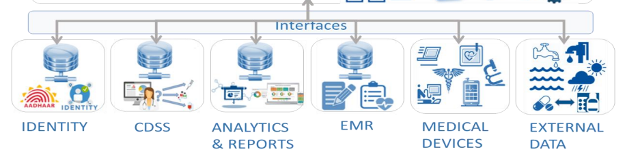
104 Technology stack information
AMRIT Platform
C-Zentrix CTI Platform
DB Open Source
Application CRM
CTI Server
Databases
Wildfly-11.0.0
Asterisks CTI
MySQL 5.7
Angular App API
PhP.7.2.4
Redis 0.3.0
Java scripts, Loadsh, Core-js
Apache Httpd web
HTML Bootstrap 3
OS C-Zentrix Custom Linux
OS Windows server 2016

Slide 19

Our Vision and Future Ventures
What we have done so far…!
What are doing now is sharing the knowledge gained by us to Public Domain as a part DPG.
ABDM Compliant
HWC Application
ABHA creation, capture and verification for seamless patient registration
Building Health Information Provider (HIP) services to share digital records vis Personal Health Records (PHR) app
Developing Health Information User(HIU) Services to provide view of Patients Medical History to authorized healthcare workers with complete consent
Care in pregnancy & Child-Birth
ECD
Neonatal and Infant care
Childhood and adolescent healthcare
Family planning, contraceptive services and other reproductive care services
Management of Communicable diseases and General Outpatient care for acute simple illness and minor ailments
Screening, Prevention, Control and Management of Non-Communicable diseases
Implemented in Assam.
AMRIT Deployments in Pan India
104 HIHL in ASSAM and Bihar
TM in Maharashtra, UP, Chhattisgarh, Telangana, Assam, Jharkhand.
1097 NACO in Telangana, Assam, Jaipur, Solan and Gujarat.
MMU in Pan India States
ASHA APP and Fetosense & health cube: in Assam and Bihar.

Slide 20
Was this Presentation helpful..? & Any Question..?

